Slide 1
Covid-19 Detection using Deep Learning
Hemantharaj Raguraman

Slide 2
Project Statement
Coronavirus pandemic has infected more than 150 million people and has caused 3 million deaths around the world. This project was implemented to add Deep Learning as a method of detecting coronavirus from lung X-rays. Covid detection using X-rays which can be an additional tool in the hands of medical professionals and help in speeding up the screening process.

Slide 3
Approach
1. Perform Exploratory Data Analysis and visualizations on the dataset to get a clear understanding of the data.
2. The dataset is split into 80% for training and 20% for testing. For CNN models
size of 200x200 is used. For pretrained models 128x128 is used to reduce training times.
3. The dataset is normalized as required by the pretrained models and image
augmentation is performed on the images to achieve a balanced dataset.
4. Two novel CNN models are designed and 3 pretrained models VGG-16,
ResNet-18 and DenseNet-121 are chosen for training.
5. The models are trained and tested on the dataset and results are derived.
6. LIME and Grad-CAM is implemented on the trained models to generate lung
images with heatmap to gain interpretable insights into the above models.

Slide 4
Results and Analysis
Model | Accuracy | Recall | Precision | F1 Score
CNN - 1 | 91% | 77% | 91% | 83%
CNN - 2 | 94% | 92% | 91% | 91%
VGG-16 | 98% | 97% | 99% | 98%
ResNet 18 | 98.5% | 98% | 99% | 99%
DenseNet - 121 | 99% | 98% | 99% | 99%

Slide 5
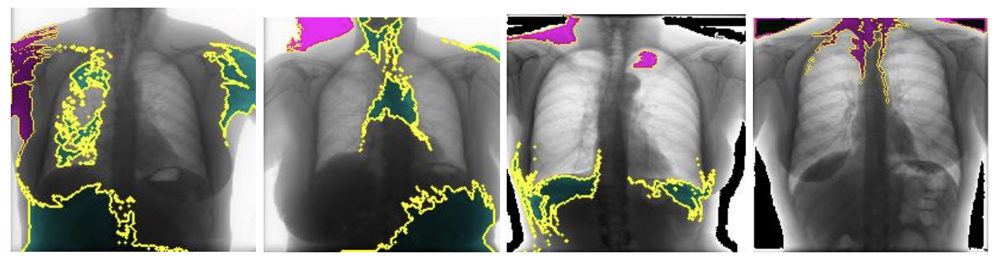
LIME CNN-1 for COVID X-Rays

Slide 6
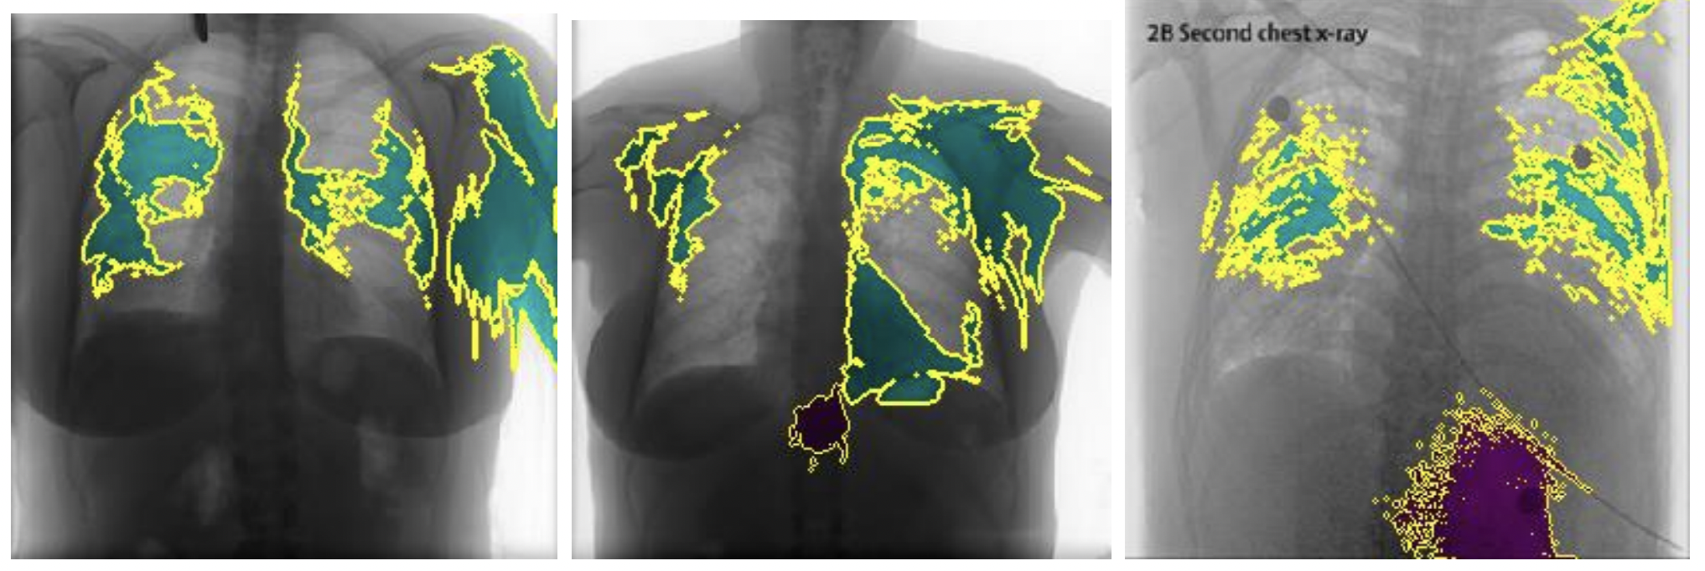
LIME CNN-2 for COVID X-Rays

Slide 7
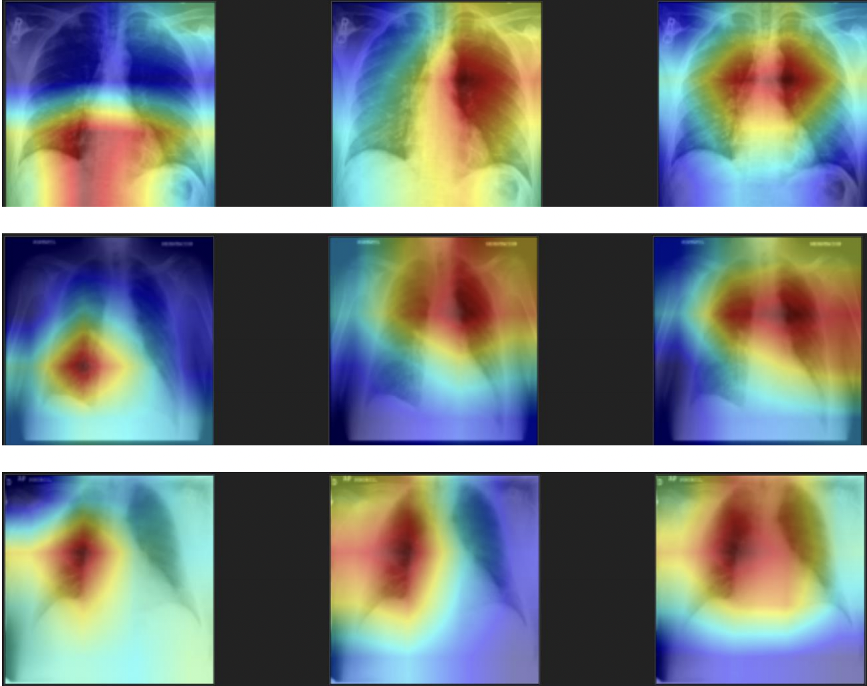
Grad-CAM for COVID X-Rays
VGG ResNet DenseNet

Slide 8
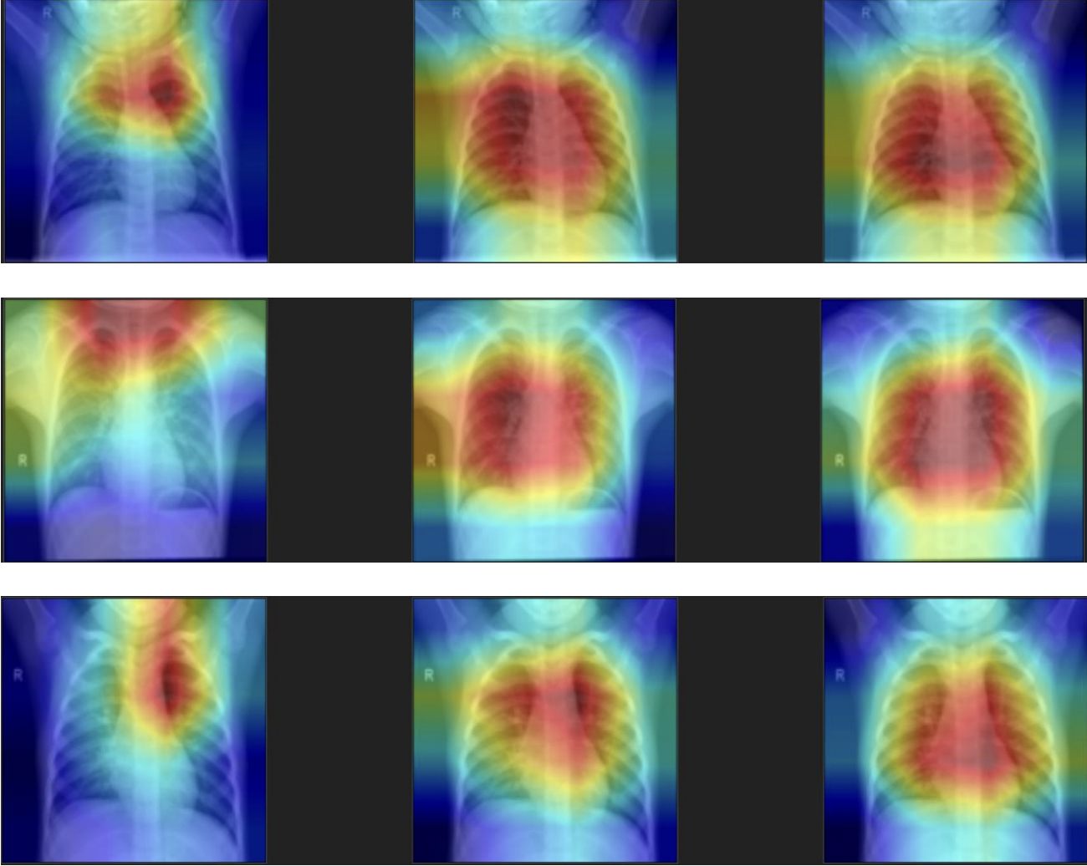
Grad-CAM for Normal X-Rays

Slide 9
Benefits and Applications
This can be used as a quick method to detect coronavirus in high case volume situations.
The accuracy of PCR tests vary across different labs but these models are consistent.
Since the input for the model is just a clear image of the X-ray they can be tested anywhere with a proper internet connection.
X-rays are more cost efficient than PCRs.
These models are easily interpretable by humans.

Slide 10
Limitations and Future Work
Limitations:
Even with high accuracy and recall these models can only be used as a preliminary diagnostic tool.
Chest CT scans are more sensitive in recognizing COVID.
Future Work:
Validate the best performing models with the help of a domain expert.
Test and compare multiple pre-trained models.
Implement advanced image augmentation techniques on the X-rays.

Slide 11
Questions?

